Slide 1

Market report
Coca cola Uzbekistan
Insights & Recommendations based on survey responses
Prepared by: Lobar Abdisoatova
Date: 11.05.2025

Slide 2
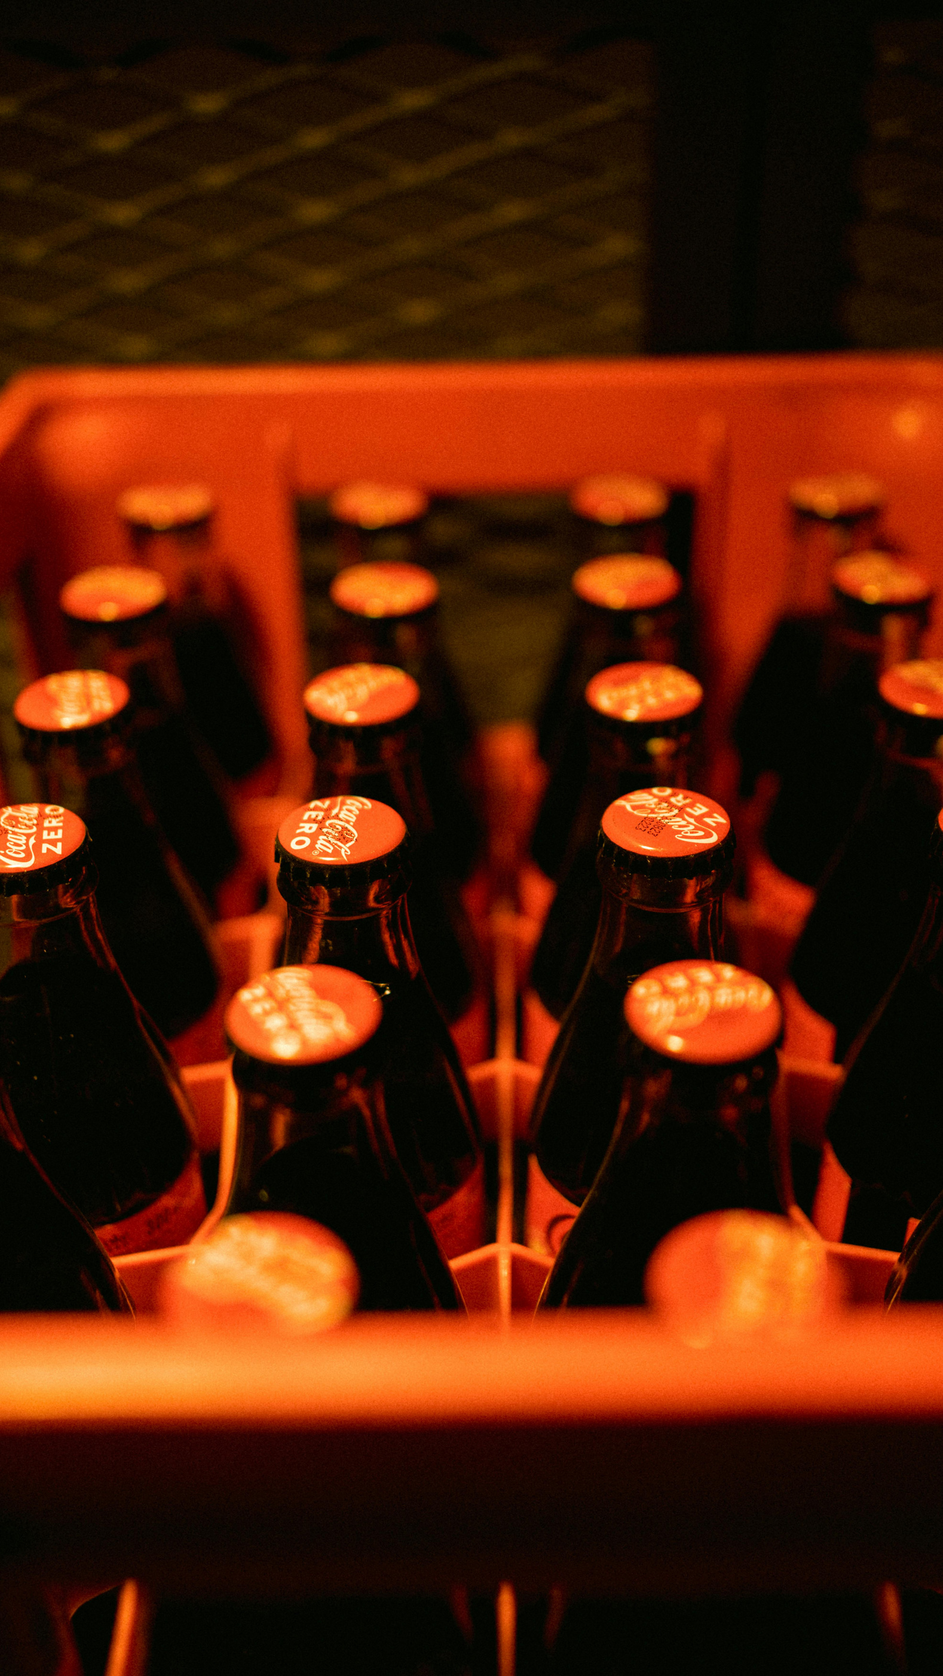
Executive Summary
This report presents insights from a consumer survey on Coca-Cola in Uzbekistan, focusing on satisfaction, brand perception, and consumer behavior. Results show strong satisfaction and frequent consumption, especially of Coca-Cola Classic, often enjoyed during social occasions like gatherings and holidays.
While overall sentiment is positive, the Net Promoter Score suggests room to improve customer advocacy. Consumers prefer buying Coca-Cola from supermarkets and associate it with enjoyable moments. Recommendations include enhancing emotional branding, partnering with popular food items like pizza, and improving product accessibility through smaller sizes and vending machines.

Slide 3

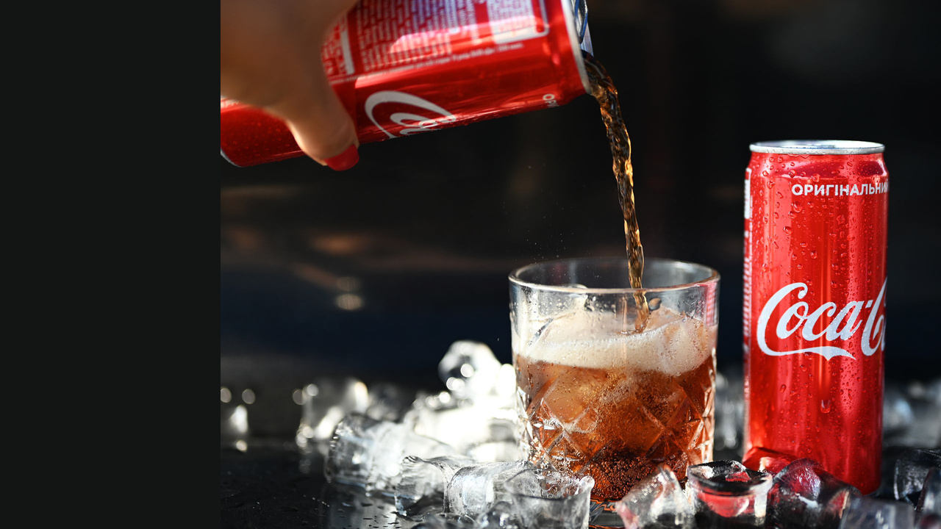
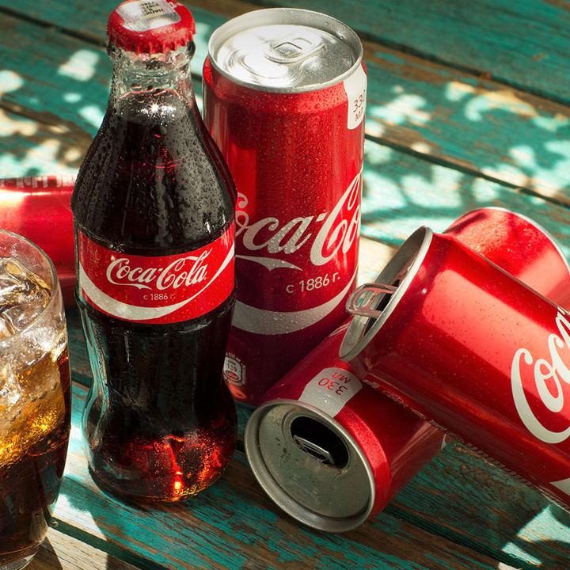

Objectives of the Survey
This market survey is primarily conducted to identify the key factors that influence consumer decision-making in relation to Coca-Cola products in Uzbekistan. By collecting data through targeted questions, the goal is to gain deep insights into consumer behavior, preferences, and perceptions toward Coca-Cola and its competitors. Additionally, the study aims to conduct a competitive analysis by understanding how Coca-Cola is positioned in the minds of young consumers compared to rival brands.
Methodology
To gather relevant data on consumer preferences and purchasing behavior, a primary research approach was adopted through an online survey developed using Streamlit, a Python-based web application framework. The survey consisted of 19 targeted questions focusing on key factors influencing soft drink choices.
The survey was distributed digitally and received 50 responses, with a majority of participants aged 19–24. Responses were collected and managed using Google Sheets, while data visualization and analysis were conducted using Tableau and Power BI to extract actionable insights.

Slide 4
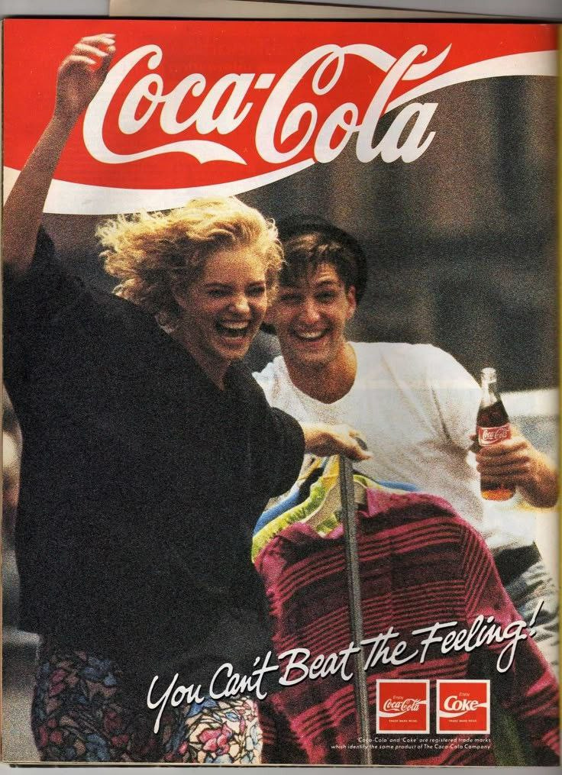
Respondent Profile
Demographic data, including age and gender, was collected for the survey; however, it was not included in the analysis to prevent potential bias. The majority of respondents were women aged 19-24, which may not fully represent Coca-Cola’s entire customer base in Uzbekistan. Unfortunately, I was unable to reach a sufficient number of male respondents or individuals from other age groups, resulting in an imbalanced sample. I acknowledge this limitation and will strive to ensure a more diverse respondent pool in future studies.

Slide 5
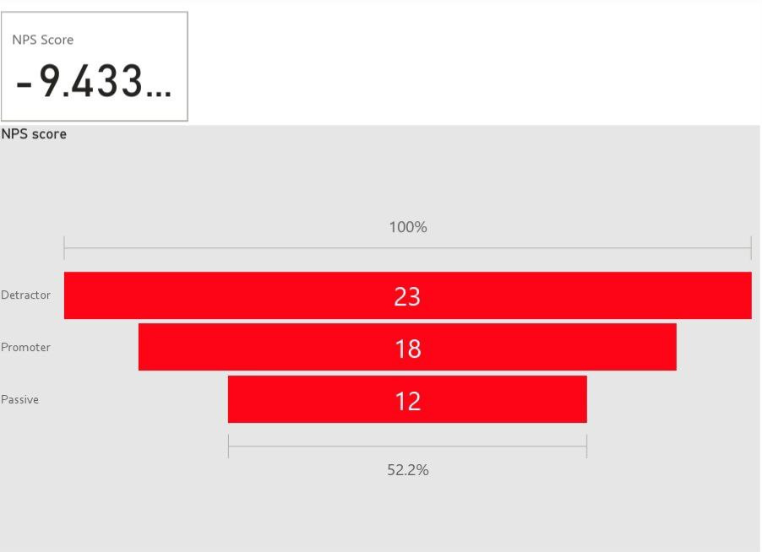

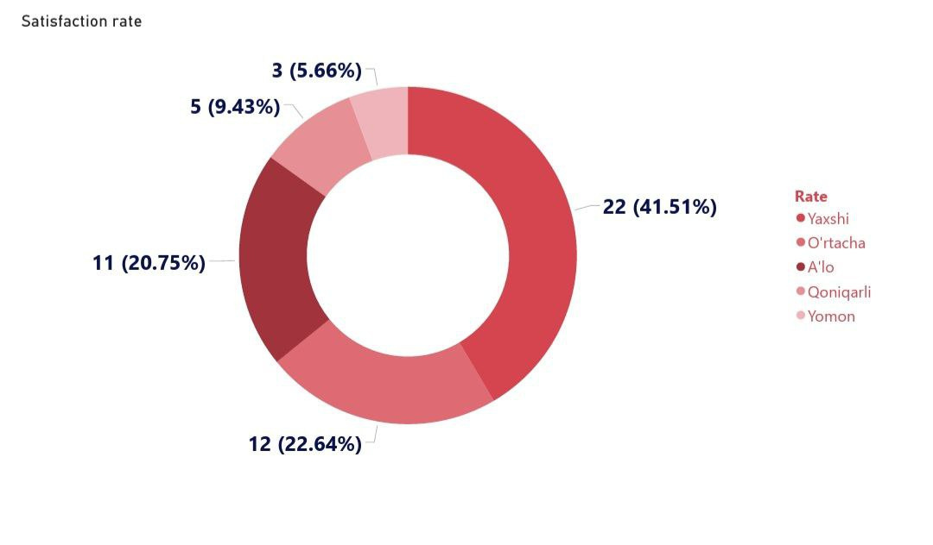
KPI
NPS score of -9.43, indicating that more customers are dissatisfied than enthusiastic about recommending the brand.
-9.433
While customer satisfaction is mostly positive, the relatively high percentage of neutral and negative responses signals opportunities for improvement

Slide 6
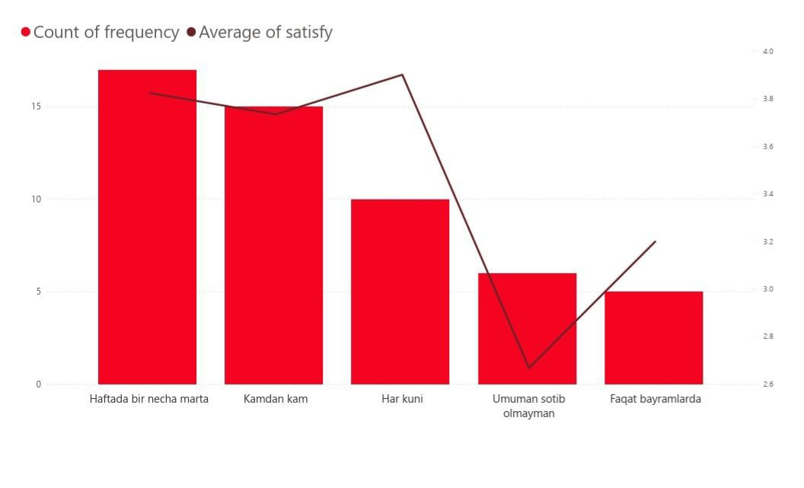
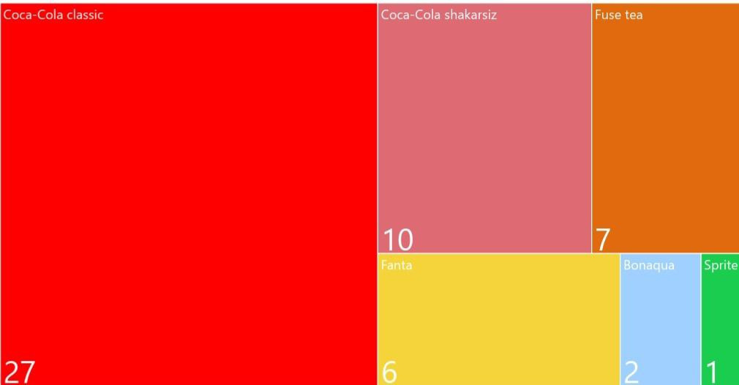
KPI
Customers who consume Coca-Cola more frequently tend to report higher satisfaction levels, indicating a loyal and engaged customer base.
Despite the presence of other variants (e.g., Coca-Cola Zero, Fanta), Coca-Cola Classic remains the dominant choice, reflecting consumer attachment to the original flavor.

Slide 7

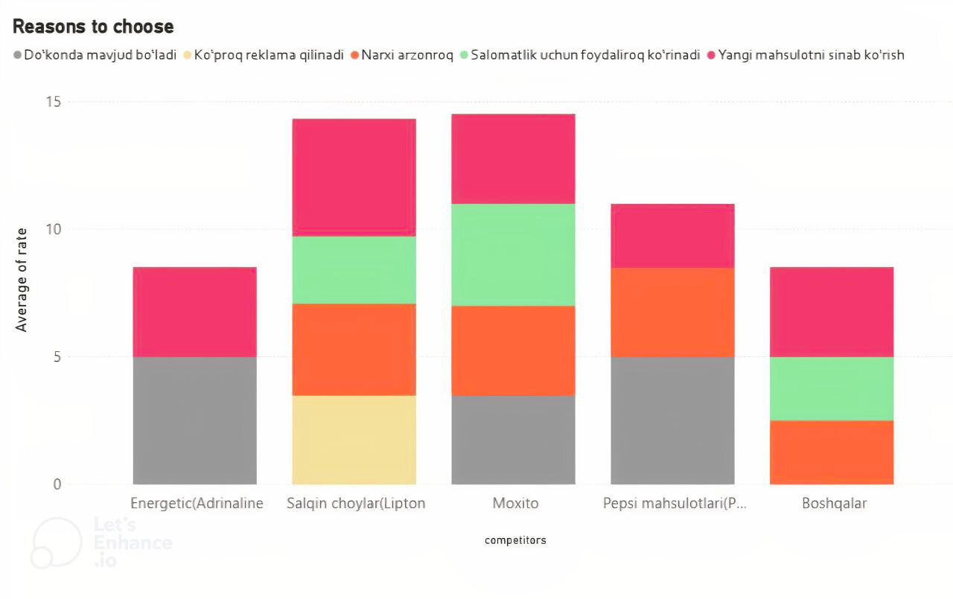
Competitive Analysis
Among those who choose other beverages instead of Coca-Cola, the most popular alternatives were non-carbonated beverages and Mojito-style drinks.
Competitors are capturing consumer interest by focusing on product innovation and health-oriented choices.
Recommendation
Promoting Coca-Cola Zero or low-sugar variants more actively to appeal to the growing health-conscious segment. This can be reinforced with messaging around well-being and wellness to align with the rising consumer demand for healthier products

Slide 8
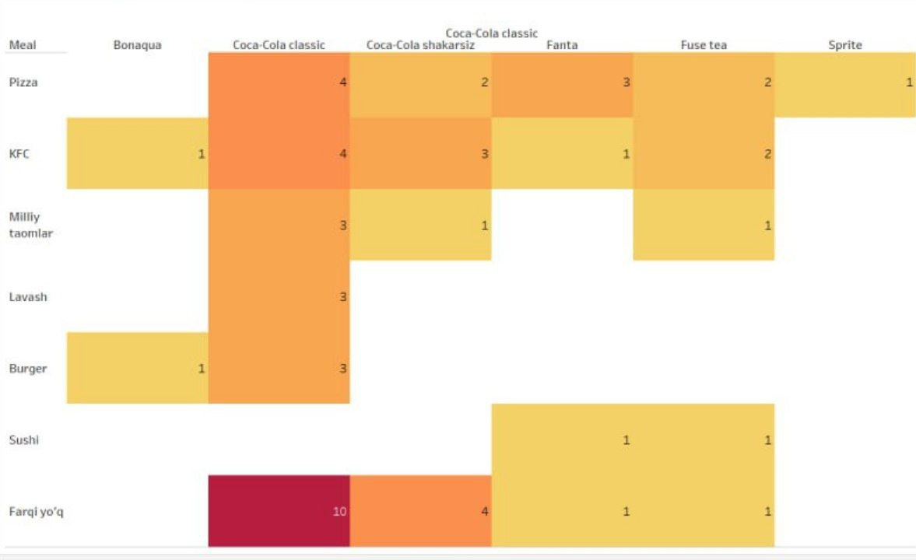
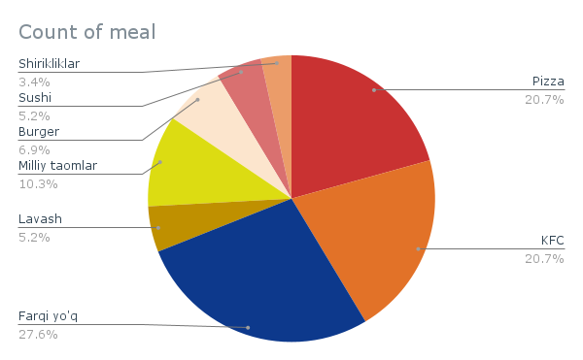


Product Basket Analysis
Coca-Cola is most commonly consumed with fast food, particularly pizza and KFC. This strong association suggests that the brand is deeply integrated into fast food dining habits, especially among younger consumers.
Coca-Cola can enhance sales by partnering with popular fast food chains to offer bundled meal deals that include Coca-Cola Classic. Promotions like “Pizza + Coca-Cola”
or “Chicken Combo + Coca-Cola” can
reinforce brand association with meals
and boost purchase frequency.

Slide 9
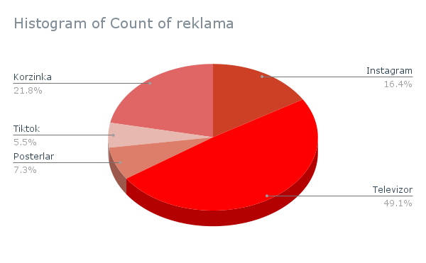
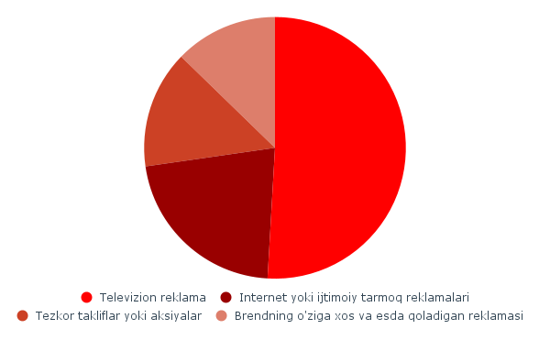
Consumer Touchpoints
Television and internet advertisements are the most influential factors in product choice. The most commonly noticed ad placements are on television and in retail environments, particularly Korzinka, emphasizing the importance of both traditional and in-store advertising.
Recommendation:
To maximize the impact of marketing spend, prioritize high-visibility ad channels such as television and digital platforms, which are most effective in reaching the target audience. Partner with retail chains like Korzinka for in-store advertising placements and seasonal promotions, ensuring brand visibility at the point of purchase.

Slide 10
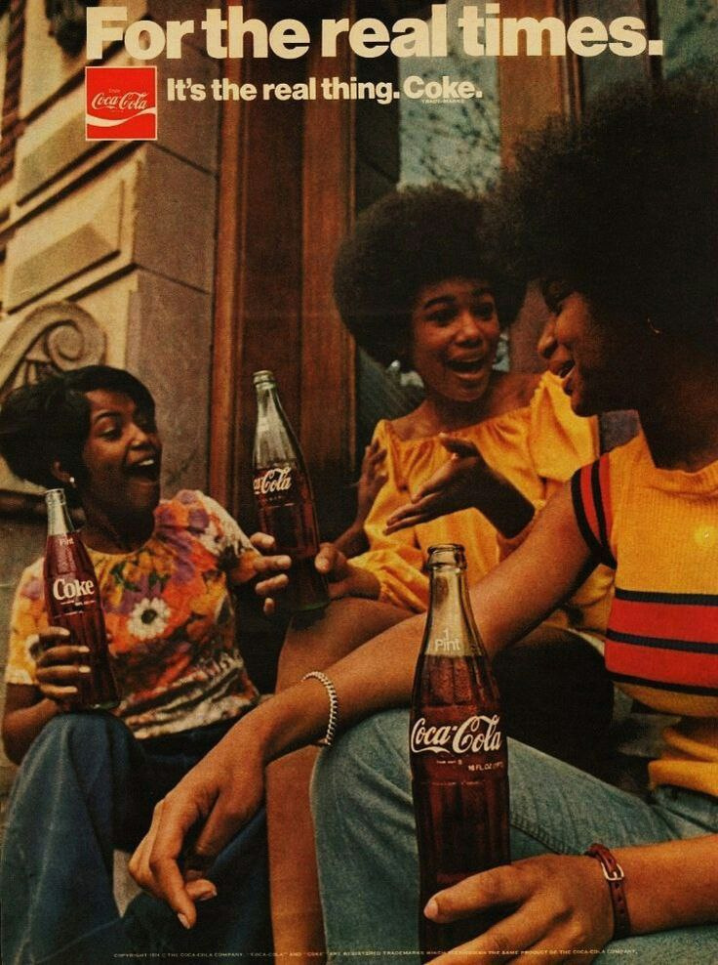
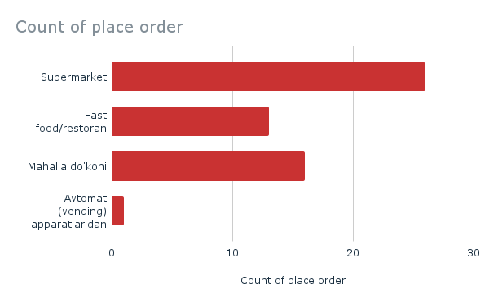
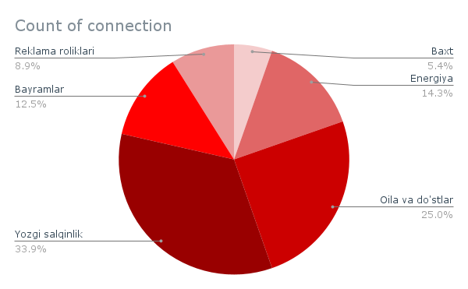
Insights on Ads
Coca-Cola is most often purchased in large supermarkets and local markets, showing its strong presence in everyday shopping locations.
Coca-Cola is widely associated with positive moments like chilling in summer, family and friend gatherings, and holidays, reinforcing its role as a companion during enjoyable experiences.
Recommendation:
Enhance in-store visibility in high-traffic retail outlets with standout displays. Use marketing to emotionally connect Coca-Cola with moments of joy and togetherness — like summer days, holidays, and social gatherings.

Slide 11
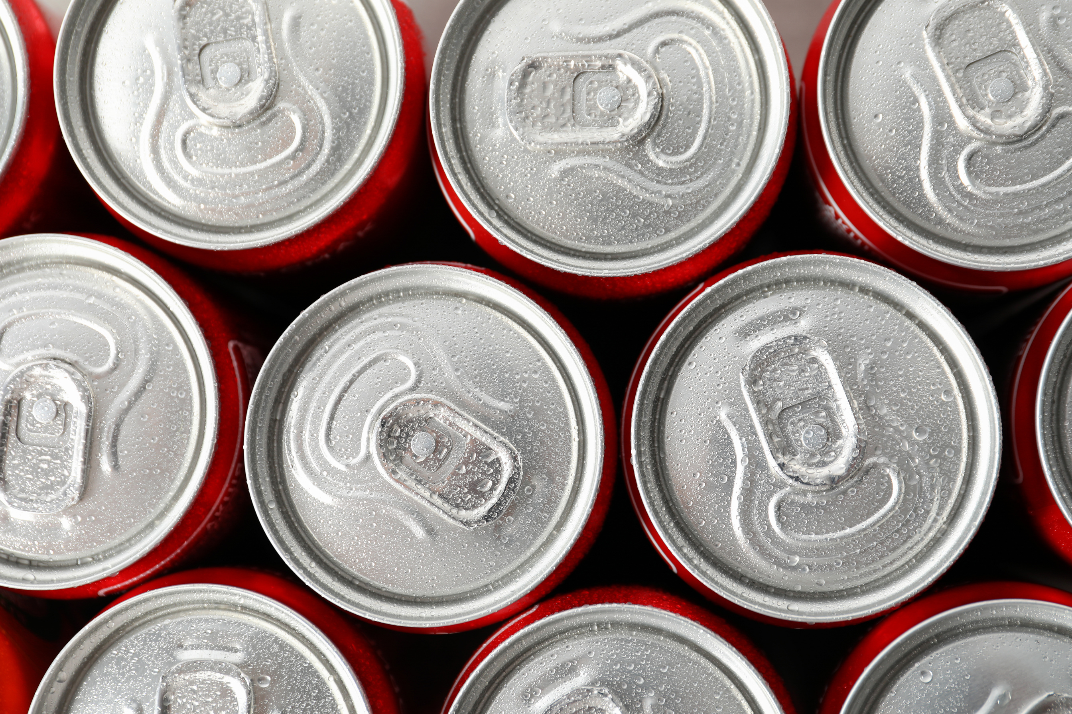
Open Feedback
Based on the open-ended feedback, the majority of consumers expressed a desire for healthier beverage options and a preference for the 250ml size. Additionally, there was a suggestion to increase the availability of Coca-Cola through vending machines in public places for better accessibility.
gap yoq zur

Slide 12
Conclusion
Customer Behavior
KPI Insights
The analysis of Coca-Cola's customer reveals valuable insights into purchasing behavior, preferences, and the influence of advertising. The high association of Coca-Cola with social moments such as family gatherings and holidays, and the strong influence of television and digital ads on product choice.
The KPIs indicate a generally positive sentiment towards Coca-Cola, with strong satisfaction and engagement among consumers. However, there is room for improvement in customer advocacy, as highlighted by the Net Promoter Score to convert passive or detractor customers into loyal promoters.
Market Position
Product Pairing
These findings suggest Coca-Cola holds a dominant position in the market but faces increasing competition. By capitalizing on its association with social moments and focusing marketing efforts with Korzinka , Coca-Cola can further strengthen its brand loyalty and market share
Coca-Cola's strong association with popular foods like pizza presents an opportunity to expand its product offerings. Introducing pizza combo promotions could effectively capitalize on these preferences, driving both product sales and brand attachment in social and dining settings.

Slide 13
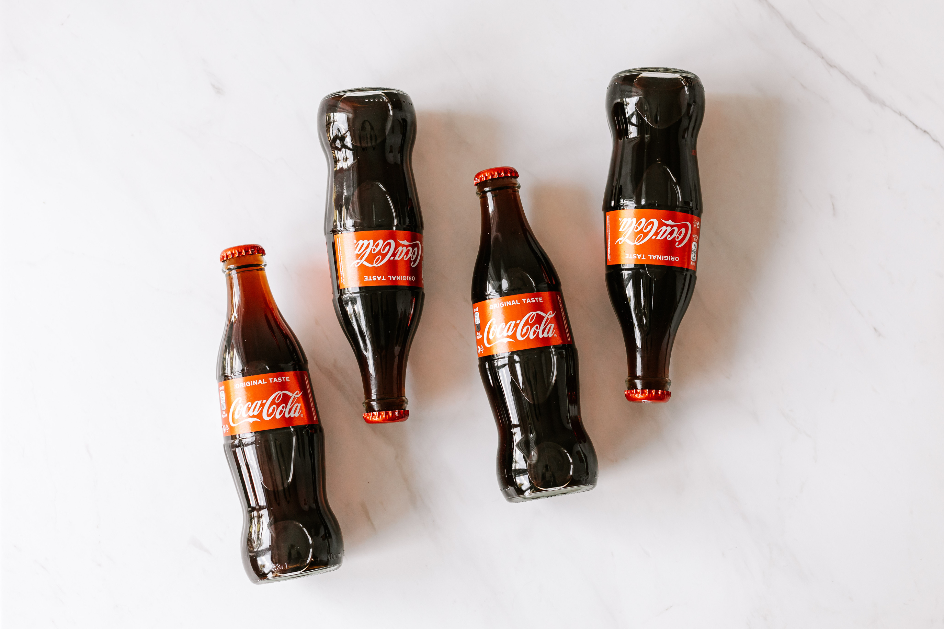
Appendix
1. Survey Form
This survey was created and distributed online to collect first-hand data.
[Link to the survey form]
2. Collected Data
Survey responses were automatically recorded and stored in Google Sheets for further analysis and visualization.
[Link to collected data]

Slide 14
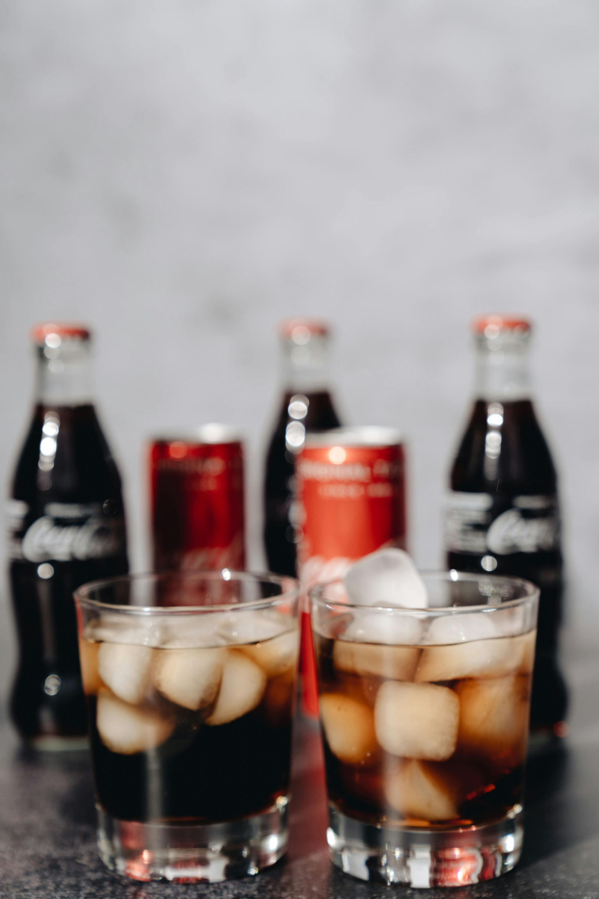
Thank
You

